Slide 1

Rapid Indexing and Searching of Genomes
Eli Ben-Michael
Cynthia Chen
Biostatistics Big Data Summer Institute
Symposium on Big Data, Human Health, and Statistics
Department of Biostatistics, University of Michigan

Slide 2
FM Indexes
Genome is long
~ 3 billion base pairs
How can we do efficient search on the genome?
How can we compress the genome?
FM Indexing
Places characters with similar right contexts together
Efficient O(1) search
Good for compression (Huffman Coding)

Slide 3
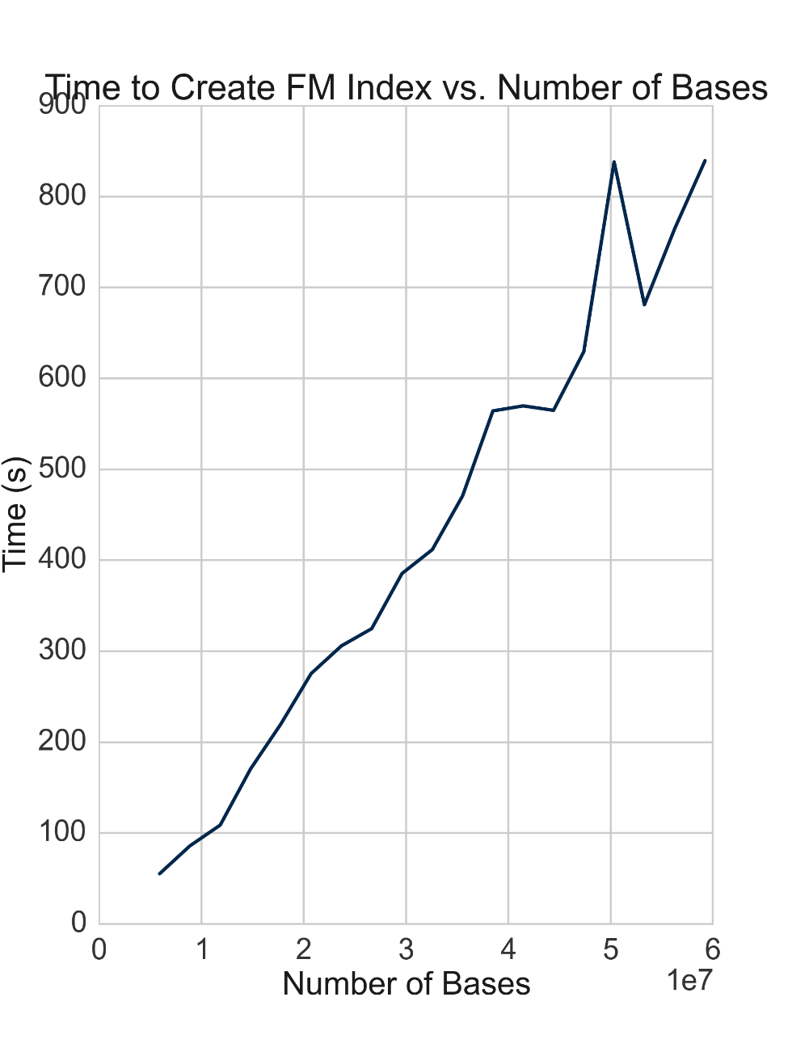
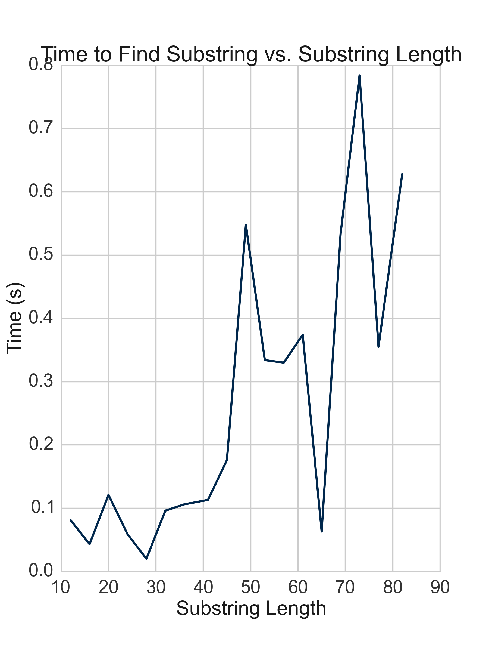
Results (1)

Slide 4
Short Tandem Repeats (STRs)
STRs
E.g.
“AC”: Association with breast cancer
“CGG”: Repeat varies based on gender
“TTAGGG”: Telomere sequence
2-13 nucleotides repeated consecutively on a strand of DNA
Important to understanding genetic variation in humans
Little is known about the frequencies

Slide 5
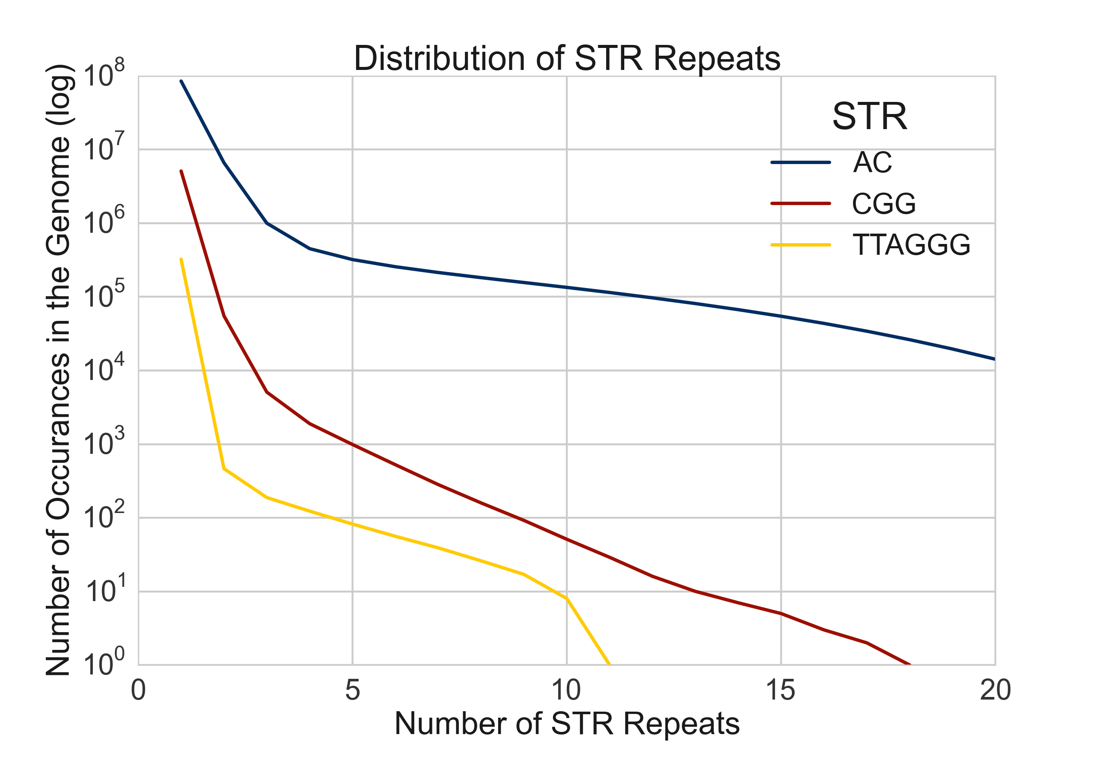
Results (2)

Slide 6
How can FM-index be used?
STRs – Short Tandem Repeats
Reference : ATGCTA (AC)_10 ATCGATTA
Variant : ATGCTA (AC)_20 ATCGATTA
Counting # of repeats for certain STR locus from aligned sequences is hard
HLA – Genomic region related to autoimmune diseases
HLA region has very high mutation rates – hard to align correctly
FM-index allows characterizing genetic variation in HLA in an unbiased way

Slide 7
Acknowledgments
Prof. Goncalo Abecasis
Prof. Hyun Min Kang
Sayantan Das
Prof. Bhramar Mukherjee
University of Michigan School of Public Health

